Slide 1

ALS Dream Challenge:
Disease Progression Sub Challenge
By: Shuyang Deng and Benedict Guzman
November 26, 2018
Machine Learning Project Fall 2018

Slide 2
Objectives
Background Information/Statement of Purpose
Data Preprocessing
Clustering Methods, Feature Selection and Exploration
Machine Learning Algorithm Implementations:
Conclusion, Future Work, and Limitations

Slide 3
Objectives
Background Information/Statement of Purpose
General Overview of Plan
Data Preprocessing
Clustering Methods, Feature Selection and Exploration
Machine Learning Algorithm Implementations:
Conclusion, Future Work, and Limitations

Slide 4
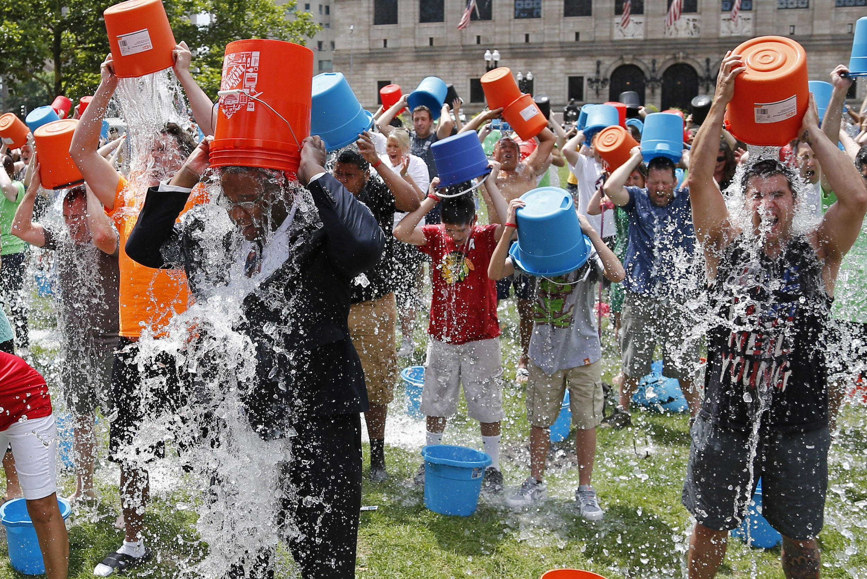
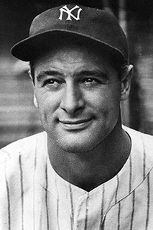
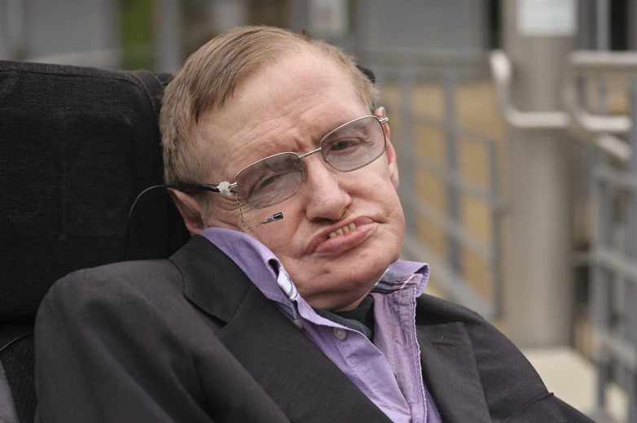
Background Information/Statement of Purpose
Amyotrophic Lateral Sclerosis (ALS) disease aka Lou Gehrig’s Disease.
Involves the death and degeneration of the nerve cells in the brain and spinal cord
Progressive loss of motor function
Death typically occurs within 3-5 years of symptom onset (1 in 1000 will die)
25% survival rate after 5 years; 10% survival rate after 10 years
Prognosis is heterogeneous
Lou Gehrig (Baseball Player): Died 2 years
Stephen Hawking (Physicist) : Died 49 years
No effective therapeutic options to cure it so far. (Riluzole only drug)
ALS Bucket Challenge
Stephen Hawking
Lou Gehrig

Slide 5
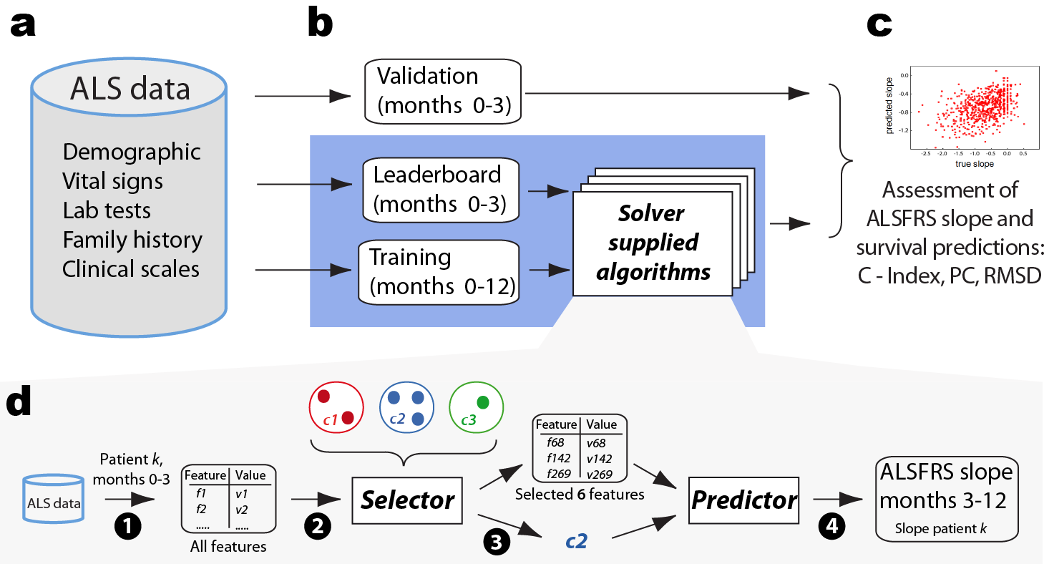
Background Information/Statement of Purpose
2012: DREAM-Phil Bowen ALS Prediction Prize4Life Challenge
2015: DREAM ALS Stratification Prize4Life Challenge
Two-Fold Goal:
Stratify ALS patients into clusters based on their common features
Predict disease progression based on data for the first 90 days and 6 variables
Disease Progression via determination of 3-12 Month ALSFRS Slope
Survival Rate on 12, 18, 24 month period

Slide 6
Objectives
Background Information/Statement of Purpose
Data Preprocessing
Clustering Methods, Feature Selection and Exploration
Machine Learning Algorithm Implementations:
Random Forests
Gradient Boosting Machine
Lasso Regression
Elastic Net
Conclusion, Future Work, and Limitations

Slide 7
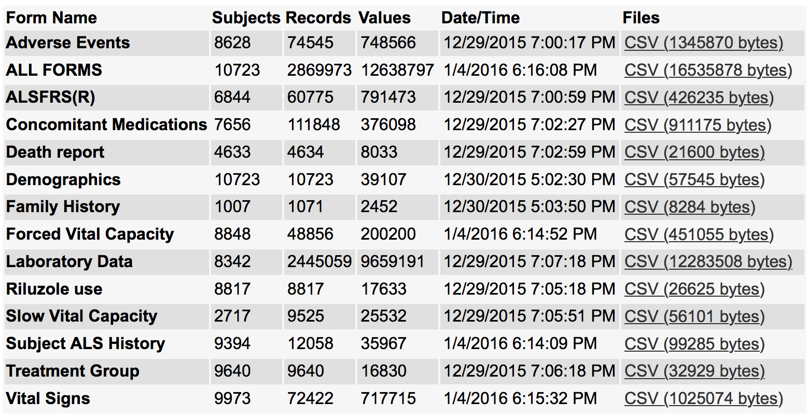
II. Data Preprocessing
2 Datasets to choose from:
ALS Registries (data collected from Ireland and Italy as part of clinical visits of ALS patients)
Pooled Resource Open-Access ALS Clinical Trials (PRO-ACT) platform (data collected from over 10,000 ALS patients from 23 completed clinical trials).

Slide 8
II. Data Preprocessing: Rules
90 days of the start of the clinical observation
Remove variables that have more than 75% missingness
Computed the mean for variables that have multiple values for the same patient (e.g. glucose level at different time points)
Only the ALSFRS_Total and ALSFRS_Delta were used to calculate the ALSFRS_Slope. Specifically, the 2 points that were used was the baseline ALSFRS_Total score (ALSFRS_Delta=0) and the last ALSFRS_Total score before ALSFRS_Delta was greater than >90 days.
Binarize the values of variables that are originally factors into zeroes and ones (e.g. Sex: Male=1, Female=0)
Impute missing data (NA values) using the Multivariate Imputation by Chained Equations (MICE) via cart method in the mice library
Final Dataset: 3180 Patients and 40 Features - Created One CSV file: ALS_FINAL.csv

Slide 9
Objectives
Background Information/Statement of Purpose
Data Preprocessing
Clustering Methods, Feature Selection and Exploration
Machine Learning Algorithm Implementations:
Conclusion, Future Work, and Limitations

Slide 10
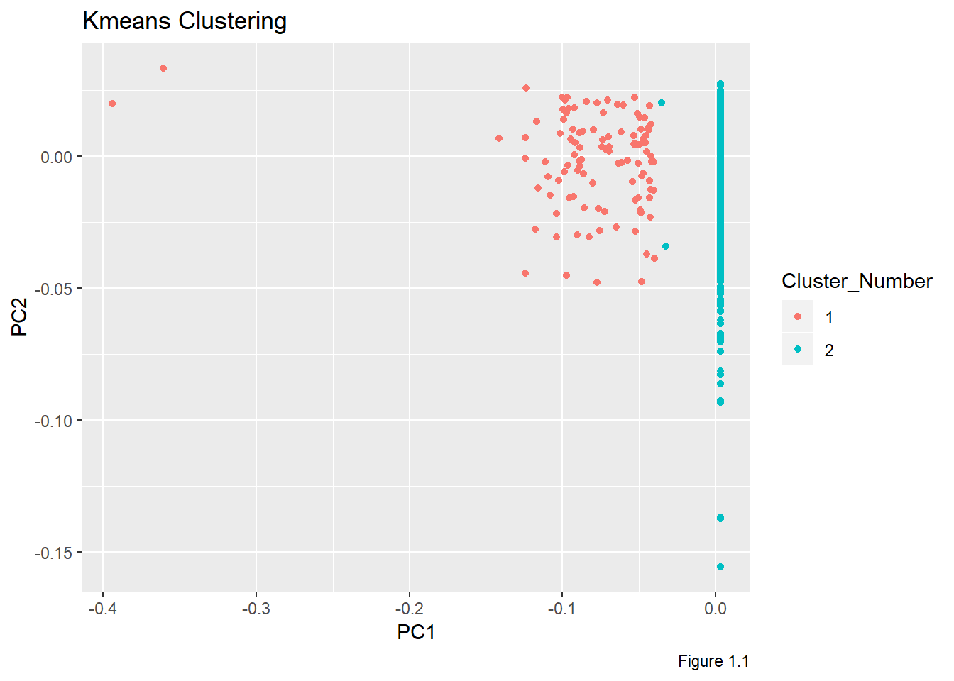
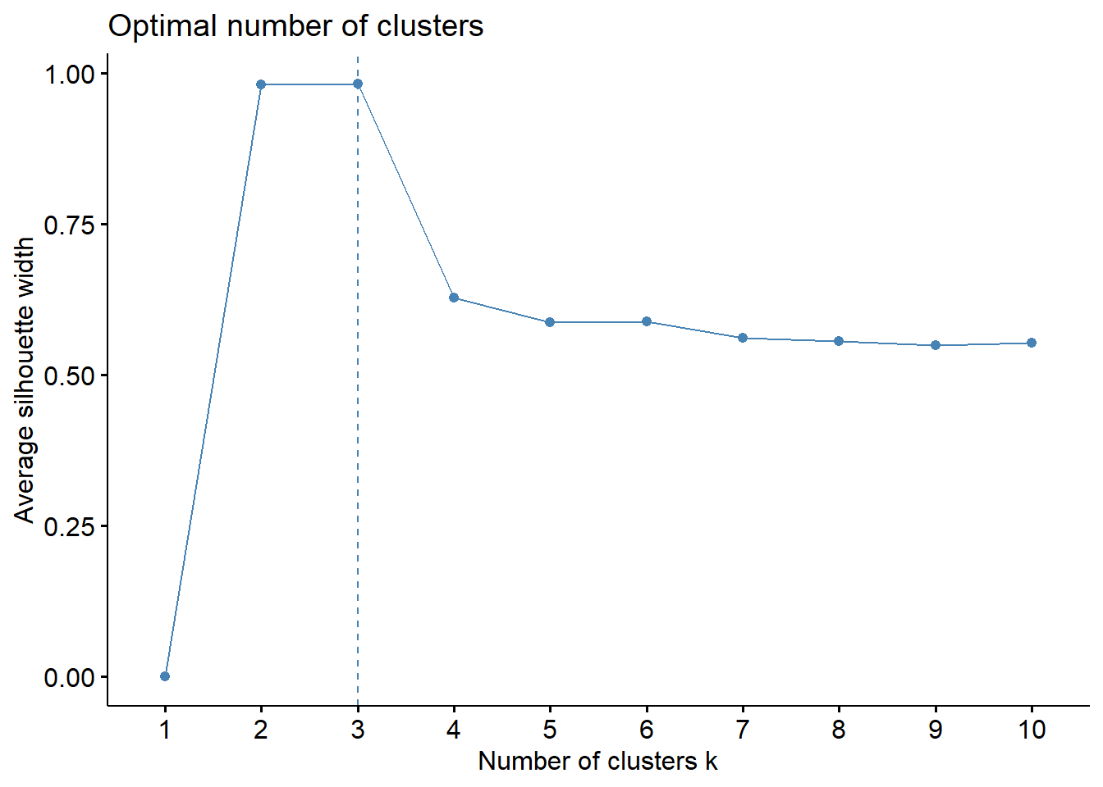
III. Clustering Methods, Feature Selection and Exploration
Clustering Method: Kmeans

Slide 11
III. Clustering Methods, Feature Selection and Exploration
Feature Selection Method: Recursive Feature Selection (Pick top 6 Features) via Random Forests method
Cluster 1: Q3_Swallowing, Q2_Salivation, Site_of_Onset, Subject_Liters_Trial_1, Q7_Turning_in_Bed, Study_Arm
Cluster 2: Site_of_Onset, Q2_Salivation, Q3_Swallowing, Subject_Liters_Trial_1, ALSFRS_Total, Q5a_Cutting_without_Gastrostomy
Created 2 separate csv files: cluster1.csv and cluster2.csv

Slide 12
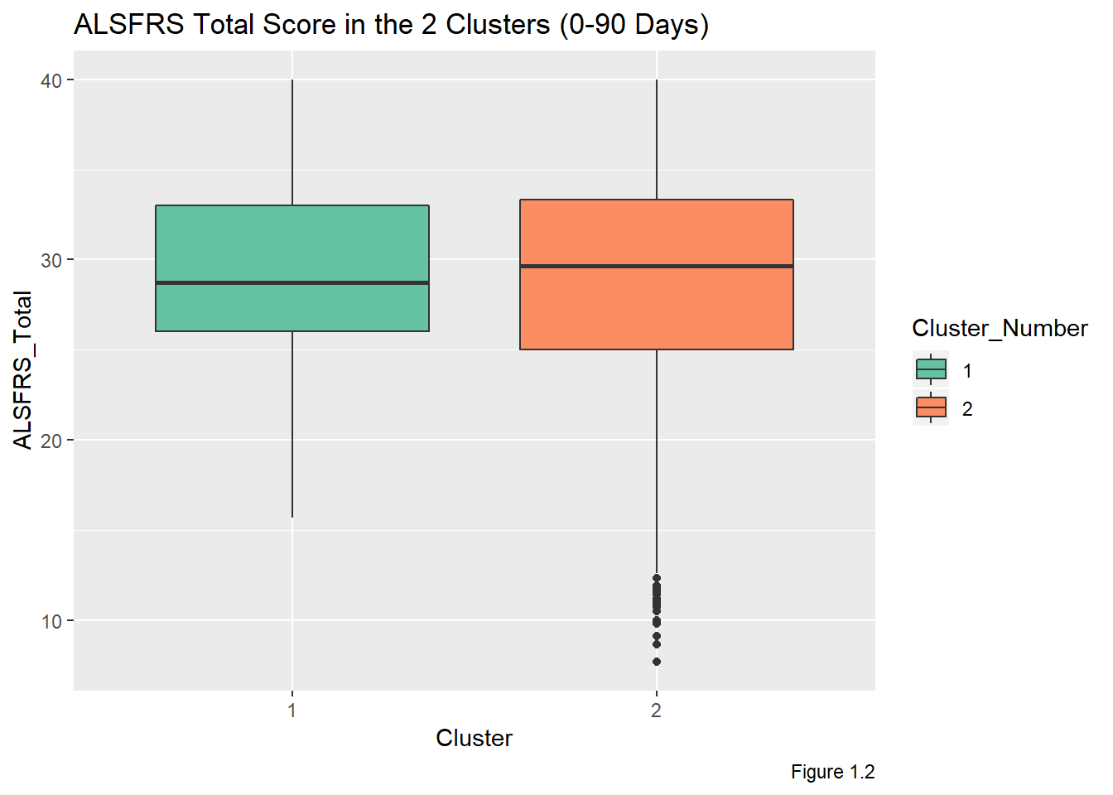
III. Clustering Methods, Feature Selection and Exploration
ALSFRS Score
Measures symptom severity
Comprised of 10 assessments (e.g. ability to swallow, walk, and write)
Each is scored as 0 (No Function) to 4 (Complete Function)
40 (Most Functional)
Cluster 2: Higher ALSFRS Score within 90 days

Slide 13
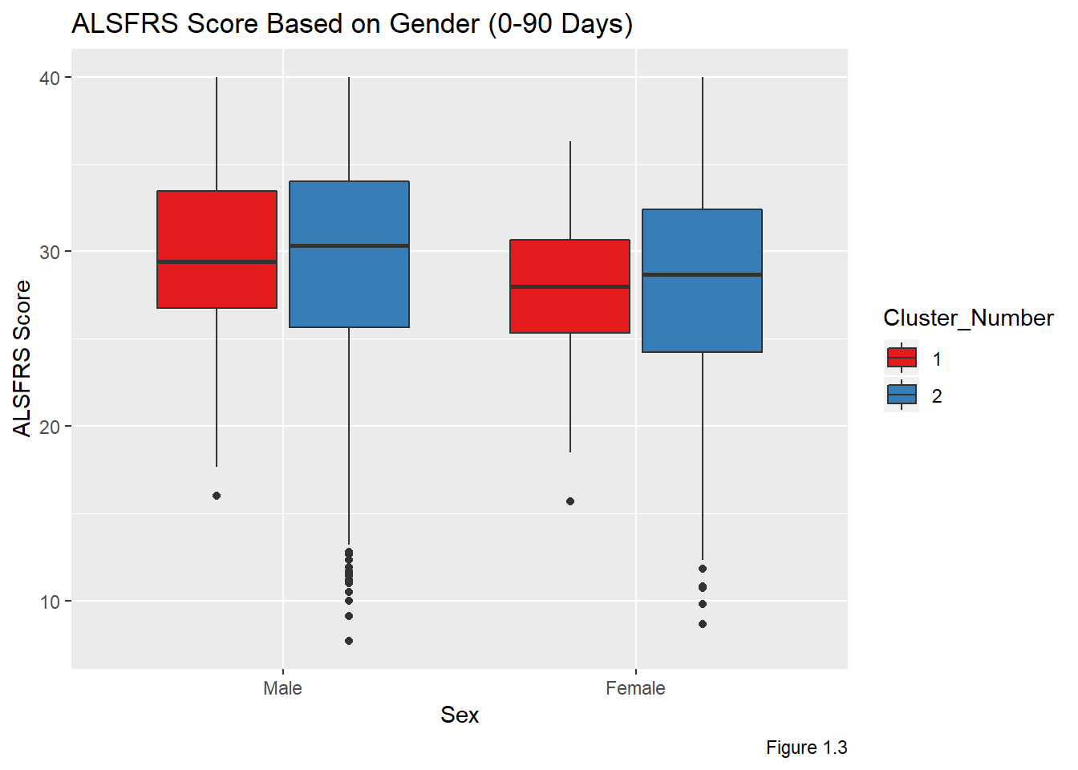
III. Clustering Methods, Feature Selection and Exploration
B. ALSFRS Score by Gender
For both clusters, ALSFRS score is lower for women

Slide 14
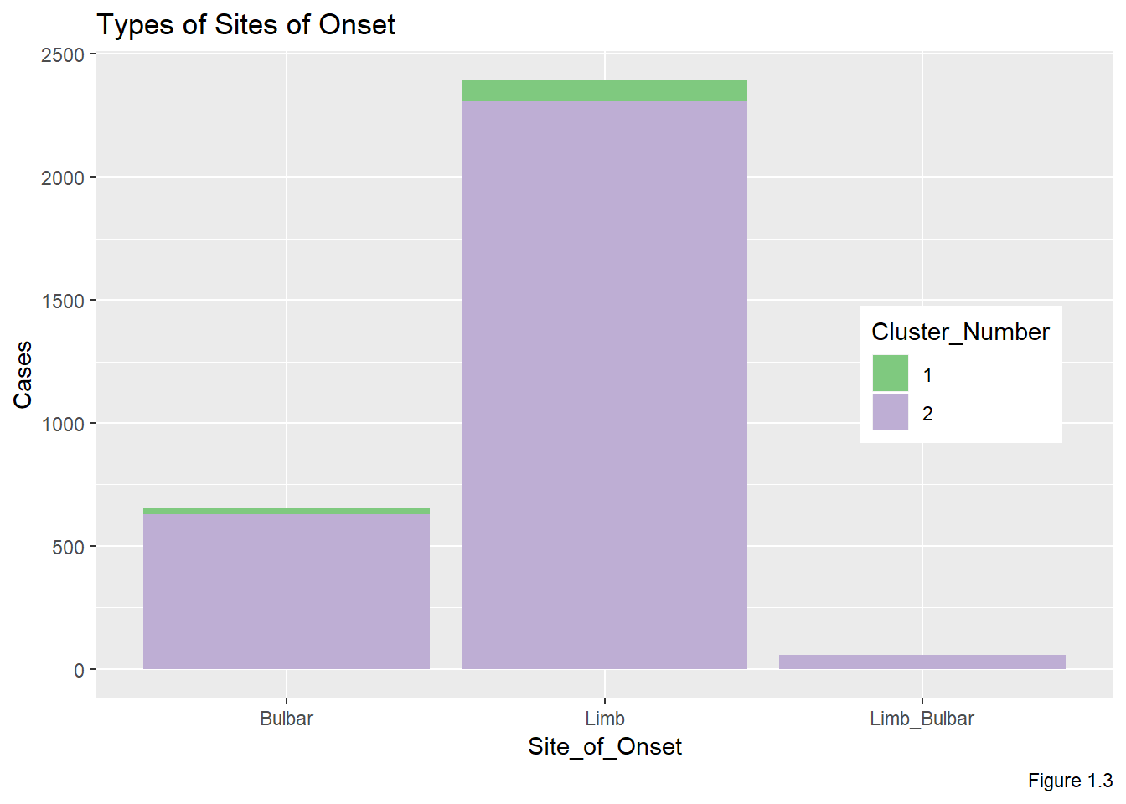
III. Clustering Methods, Feature Selection and Exploration
C. Site of Onset
3 Common Types
Bulbar (Muscles that control swallowing and speaking)
Limb
Limb and Bulbar
Regardless of cluster, limb onset is most common, followed by bulbar. Note: Limb and bulbar only found in Cluster 2

Slide 15
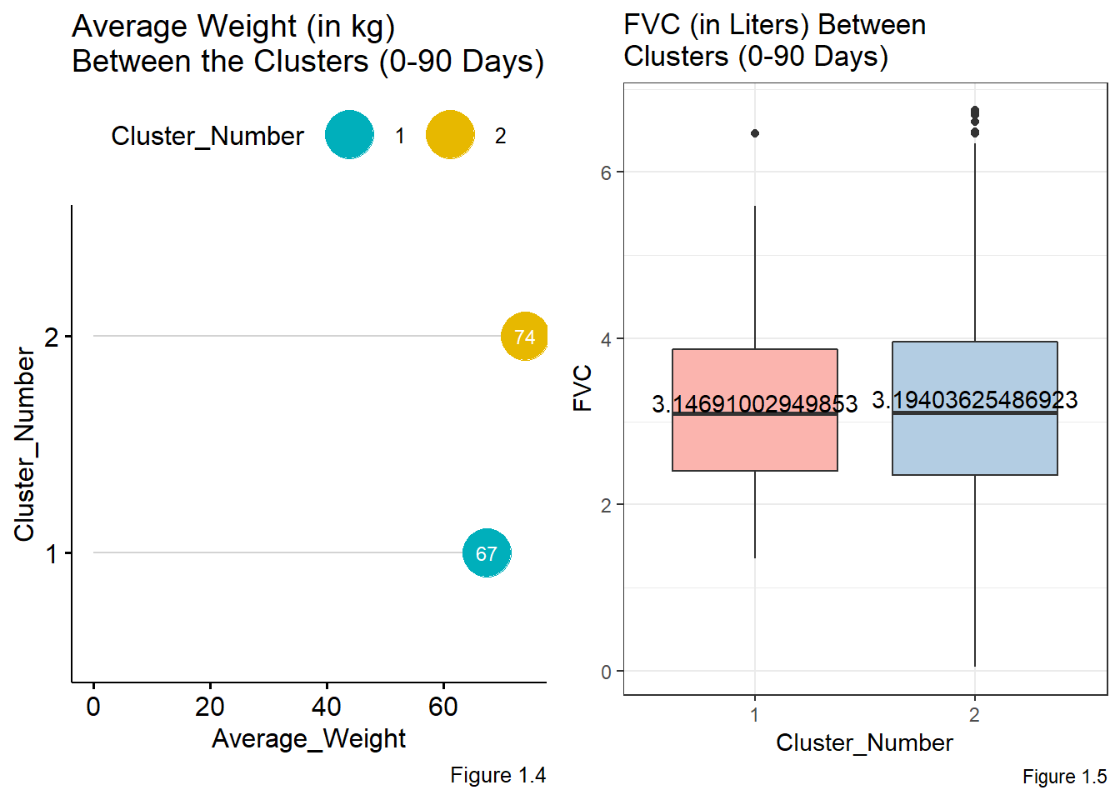
III. Clustering Methods, Feature Selection and Exploration
D. Weight and Forced Vital Capacity
FVC(Measures respiratory function: volume of air expired per inhalation)
Cluster 2: Higher FVC and Average Weight for first 90 days
Cluster 1: Showing signs of early breathing dysfunction and weight loss

Slide 16
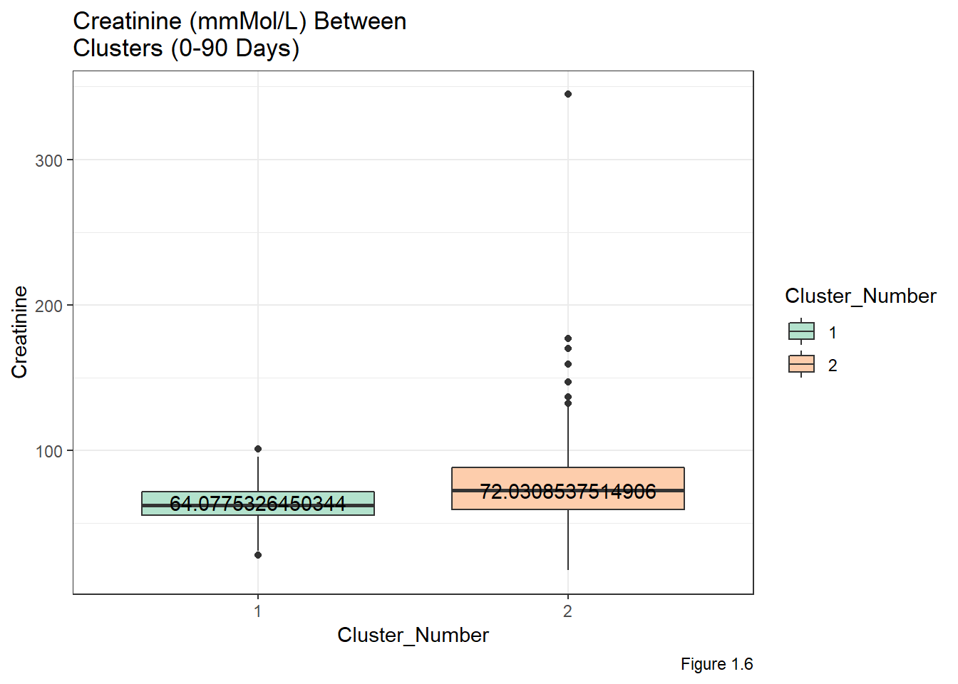
III. Clustering Methods, Feature Selection and Exploration
D. Creatinine
Normally gauges kidney function
Recently linked to ALS progression and survival rate as studied in University of Turin
The lower the creatinine, the worse the progression of ALS and survival rate
Cluster 2: Higher Average Creatinine
Cluster 1: Lower Average Creatinine

Slide 17
Objectives
Background Information/Statement of Purpose
Data Preprocessing
Clustering Methods, Feature Selection and Exploration
Machine Learning Algorithm Implementations
Conclusion, Future Work, and Limitations

Slide 18
Tree-Based Method: Random Forests
For both clusters, 60% separated for training set and 40% test set
Utilized randomForests library
Random Forests were trained and tested separately for both clusters
Tuning the Hyperparameters:
Cluster 1: mtry=1 and ntree=500
Cluster 2: mtry=3 and ntree=500

Slide 19
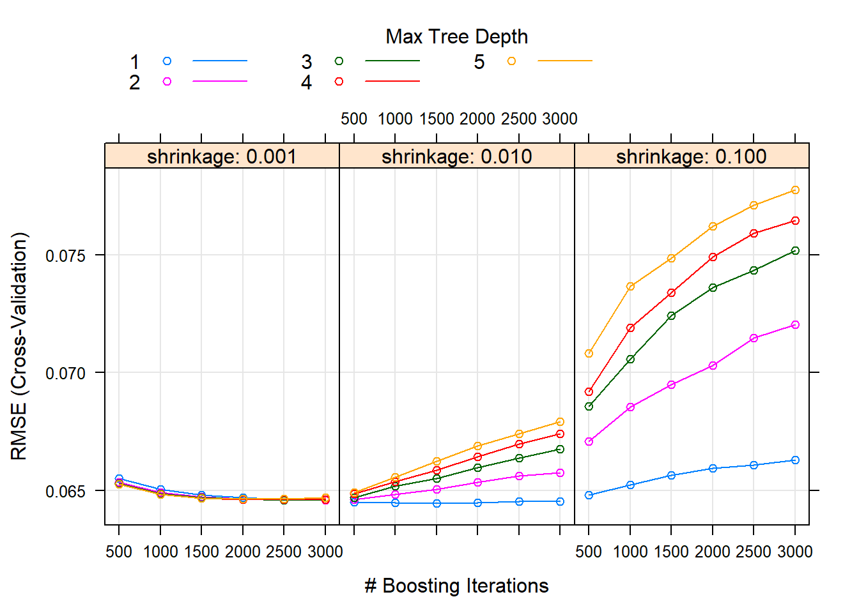
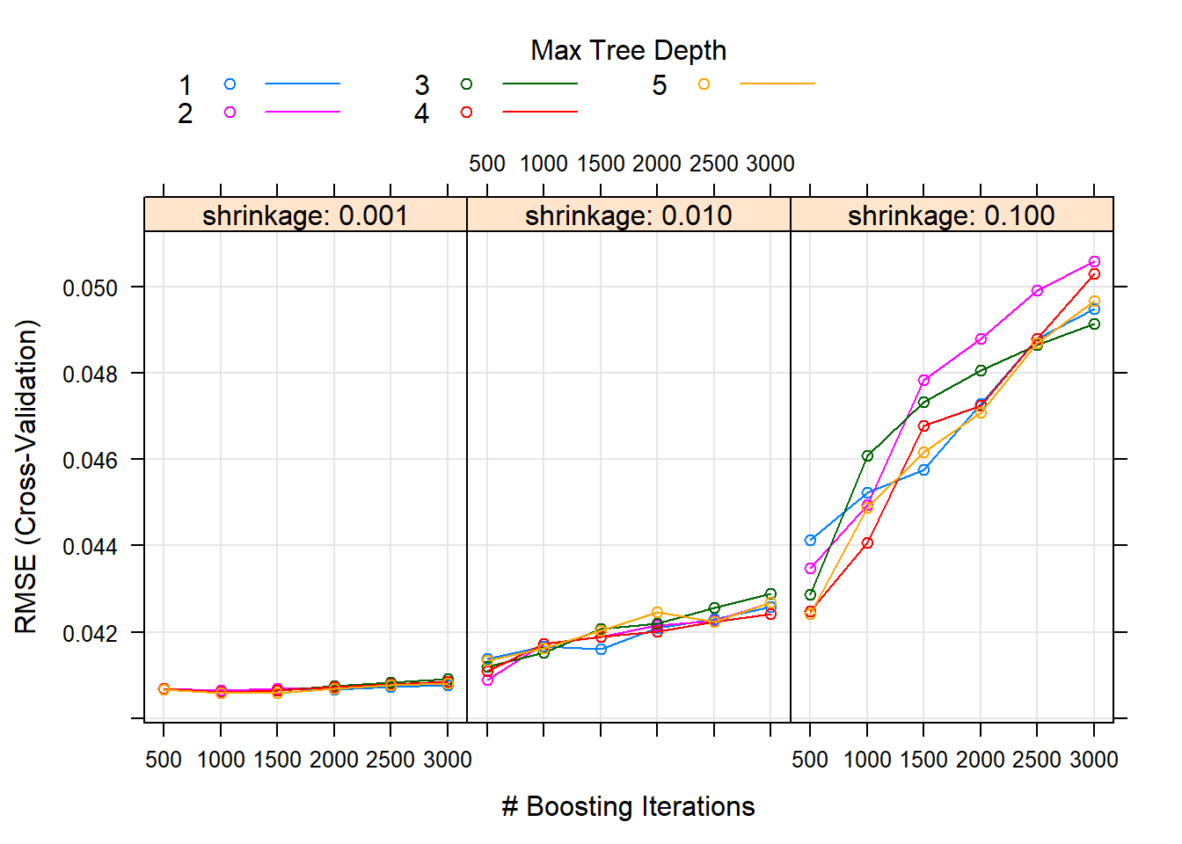
Tree-Based Method: Gradient Boosting Machine
For both clusters, 60% separated for training set and 40% test set
Utilized gbm library
GBM were trained and tested separately for both clusters
Tuning the Hyperparameters:
Cluster 1: n.trees=1500, interaction.depth=1, shrinkage=0.01, n.minobsinnode=10
Cluster 2: n.trees=1500, interaction.depth=1, shrinkage=0.01, n.minobsinnode=10
interaction.depth: number of splits for each tree
shrinkage: sets the learning rate
n.minobsinnode: minimum number of samples in a node of a tree

Slide 20
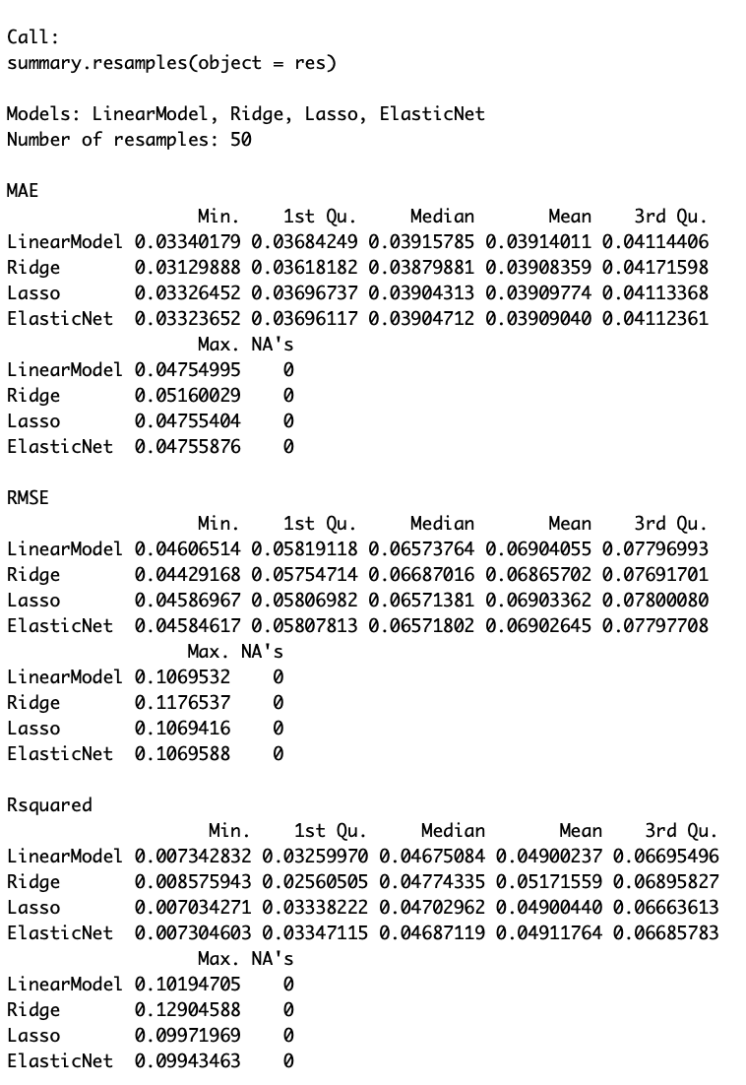
Compare modules
tuneGrid=expand.grid(alpha=1,lambda=seq(0.0001,0.05,length=5)), trControl=custom )

Slide 21
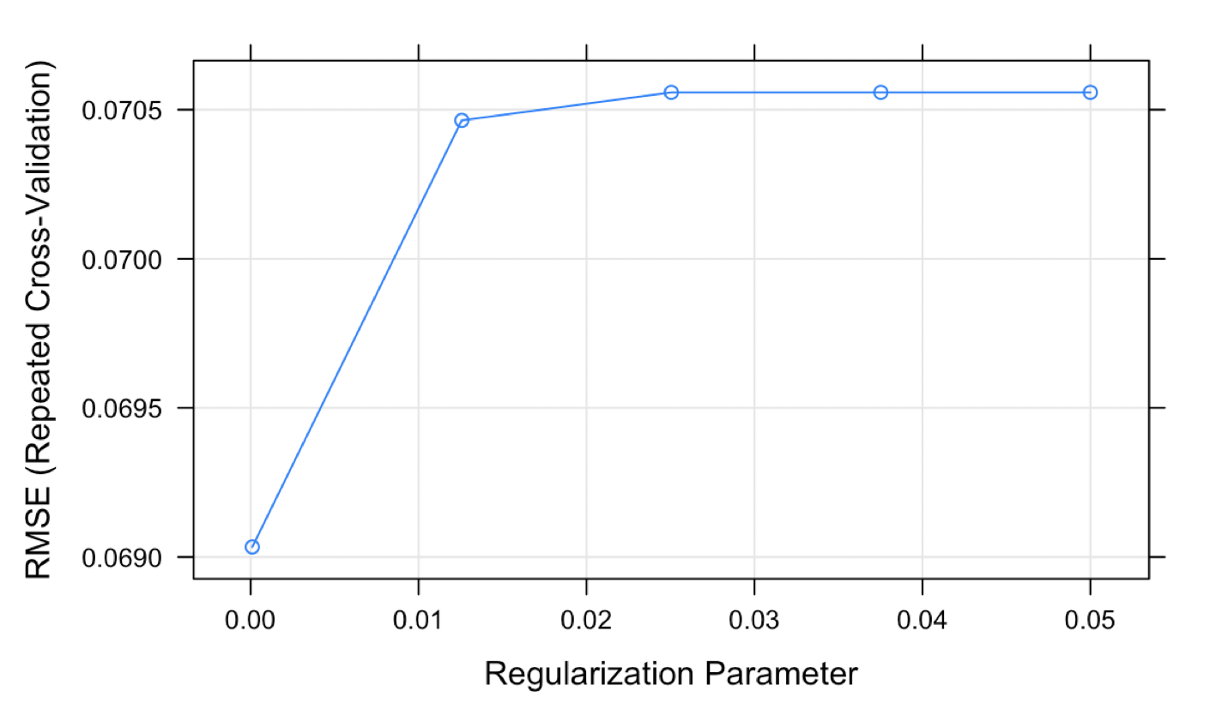
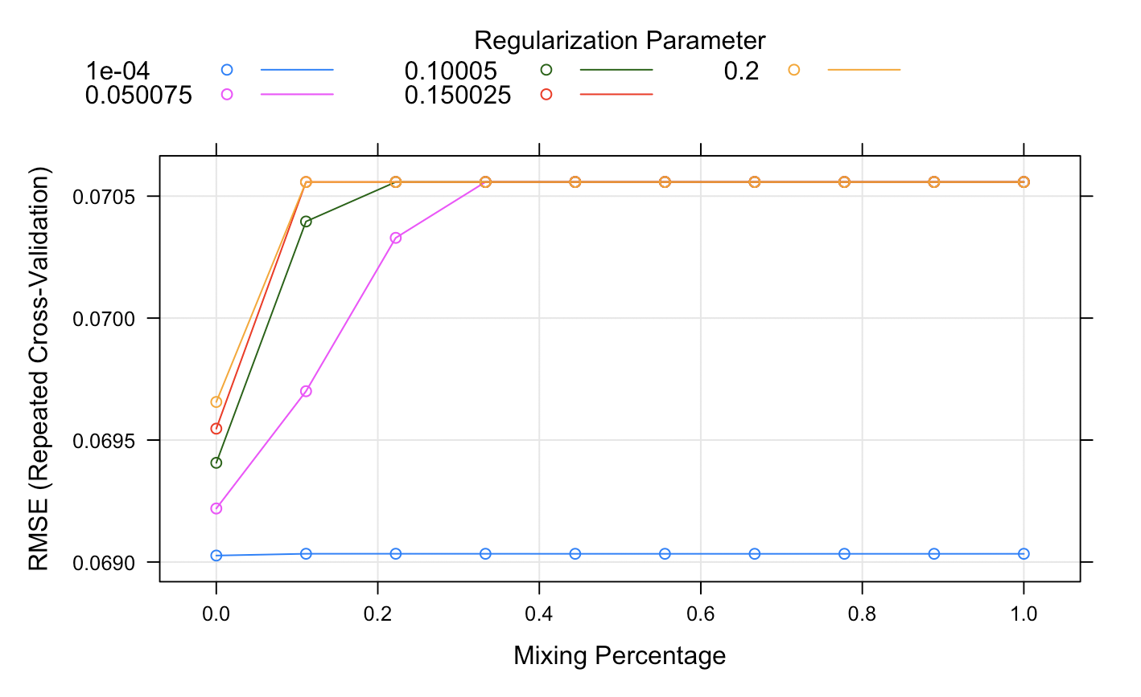
Lasso and Elastic Net
The final values used for the model were alpha = 1 and lambda = 1e-04.
Fitting alpha = 0, lambda = 1e-04 on full training set.
Lasso
Elastic Net

Slide 22
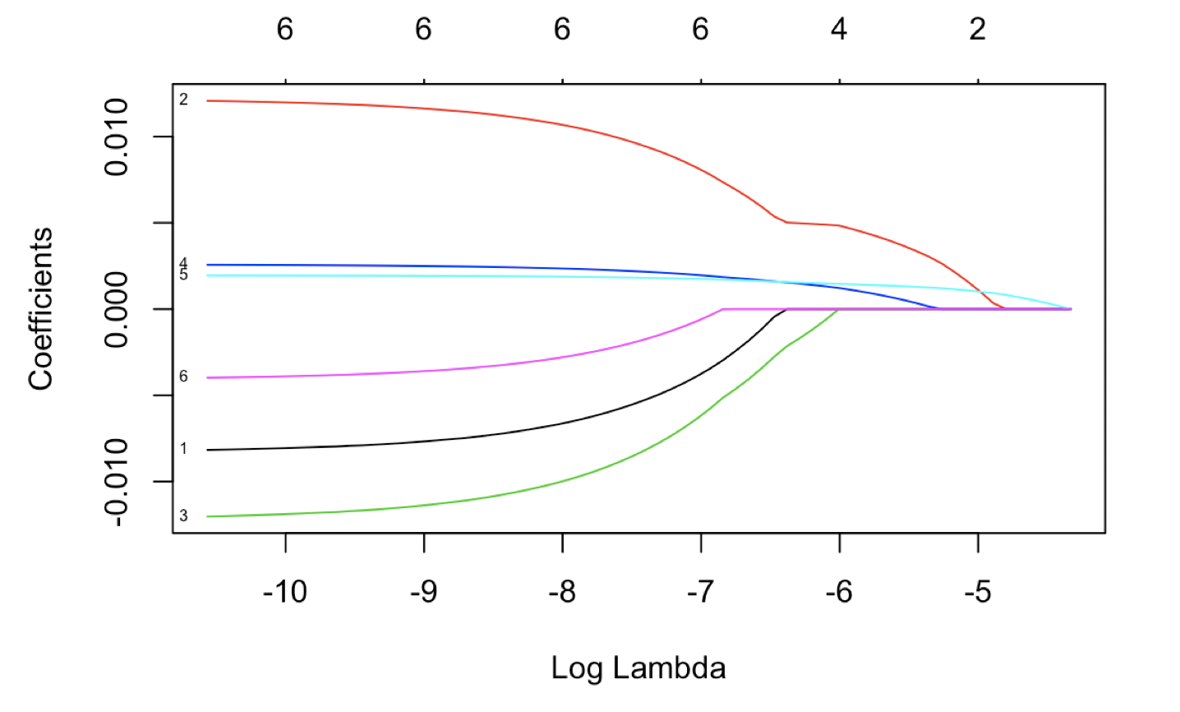
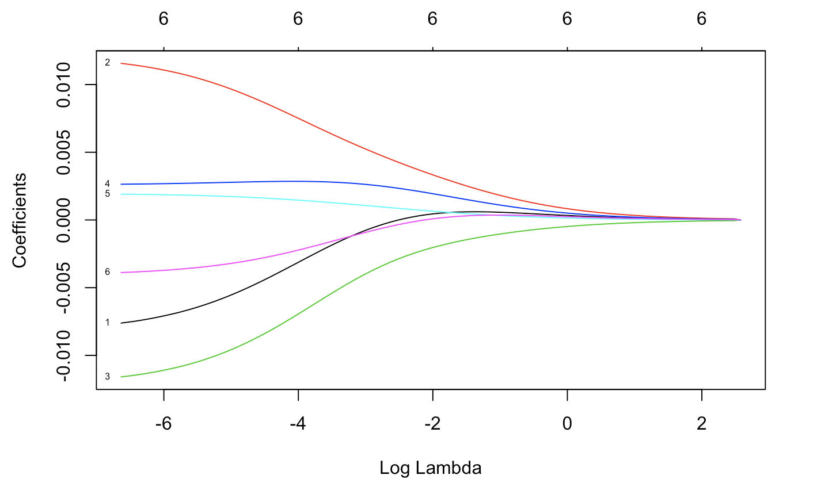
Coefficients vs. Log Lambda
Lasso
Elastic Net

Slide 23
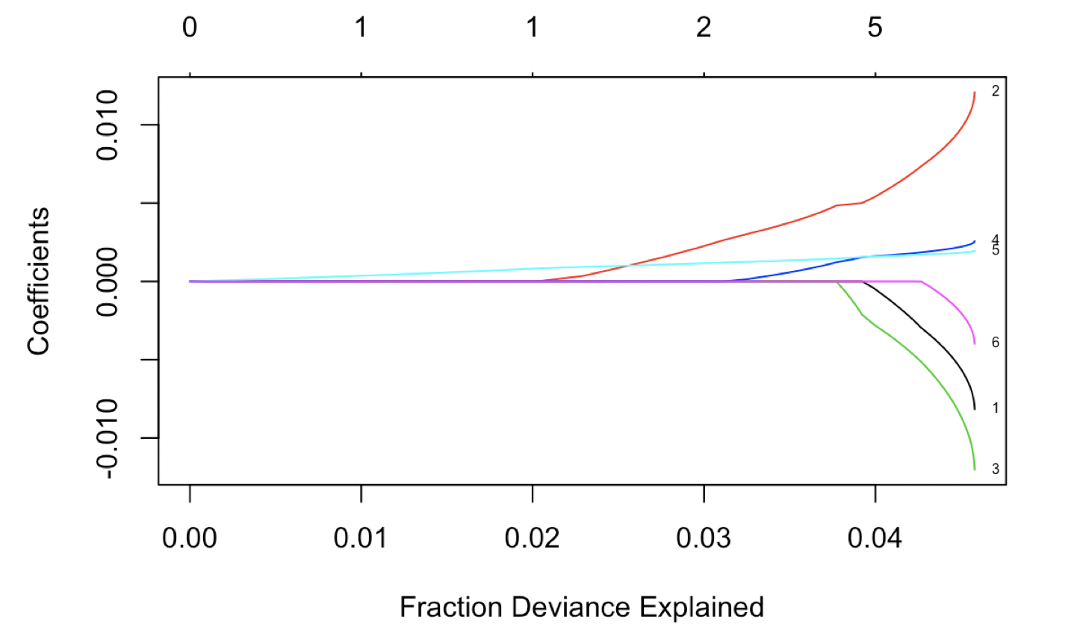
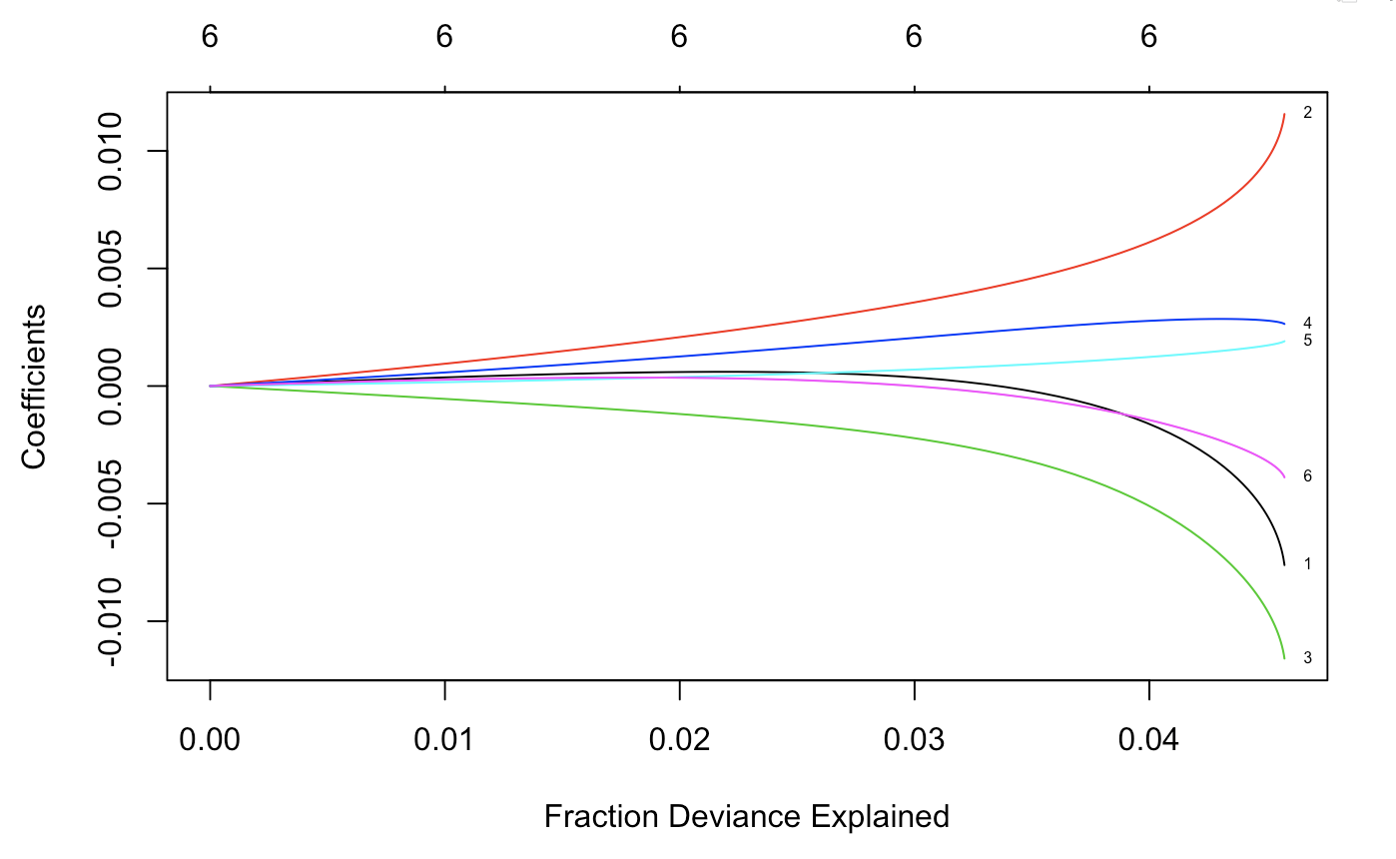
Coefficients vs. Fraction Deviance Explained
Lasso
Elastic Net

Slide 24
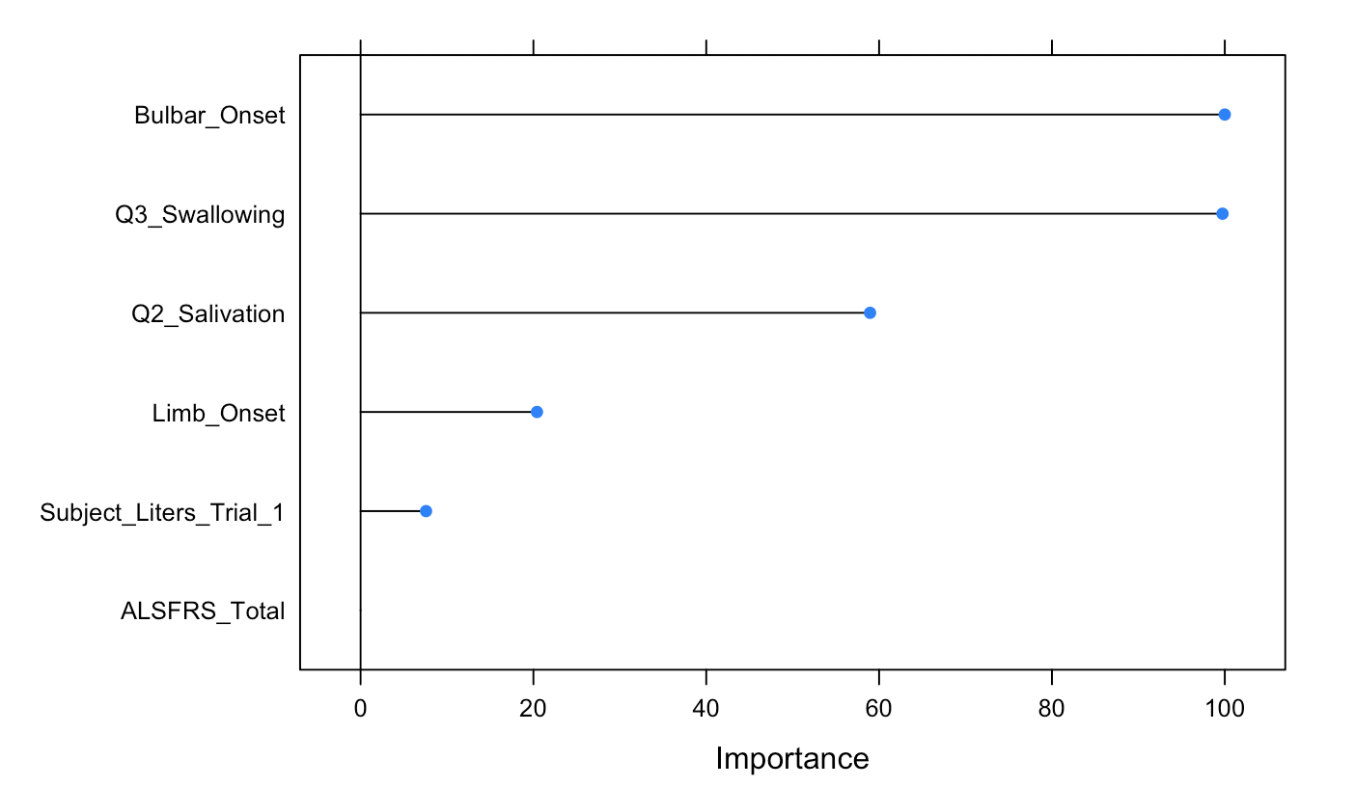
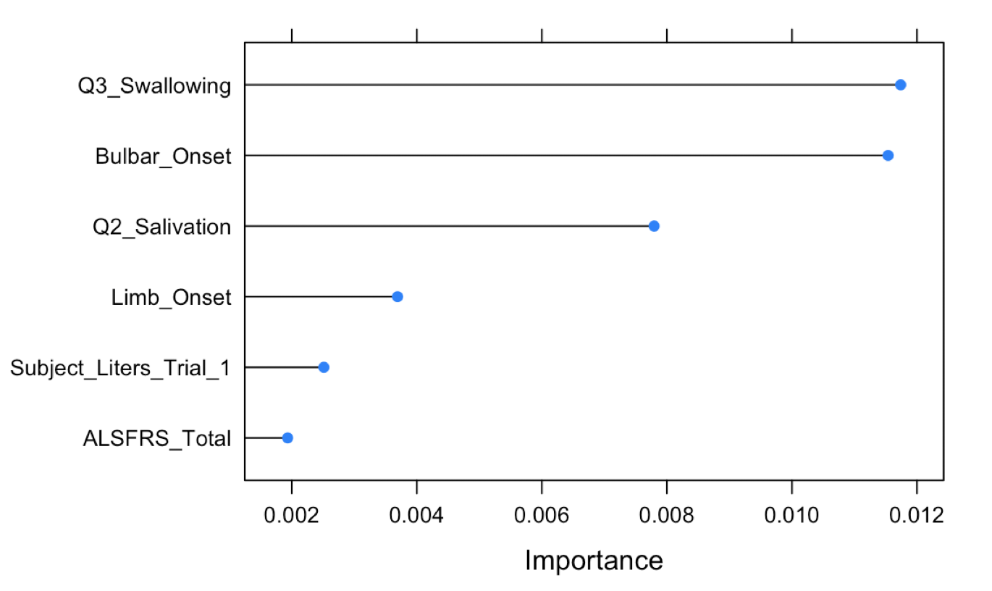
Important variables
Lasso
Elastic Net

Slide 25
Model Evaluation
Evaluation Metrics:
RMSE (Root Mean Squared Error)
MSE (Mean Squared Error)
MAE (Mean Absolute Error)
Compared with Baseline RMSE, MSE, and MAE: mean of ALSFRS Slope in the pre-prediction training set - the ALSFRS slope in the pre-prediction test set

Slide 26
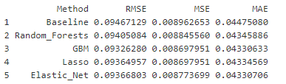
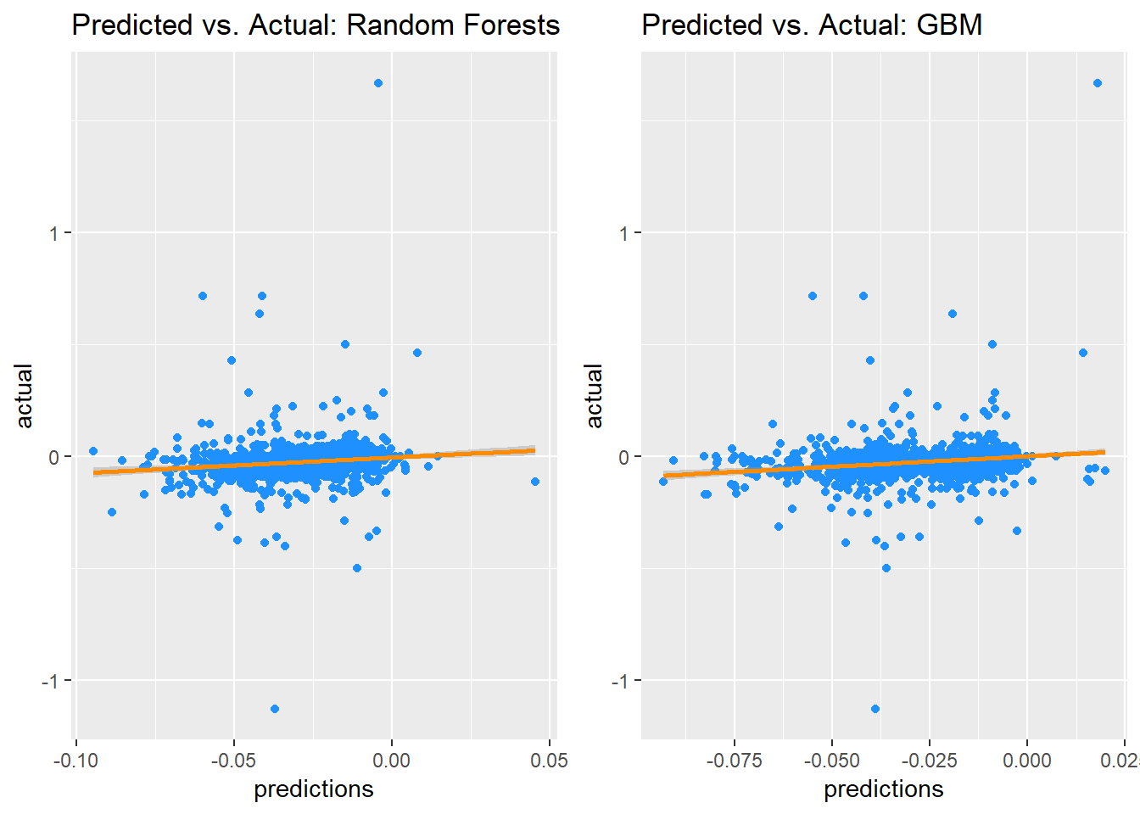
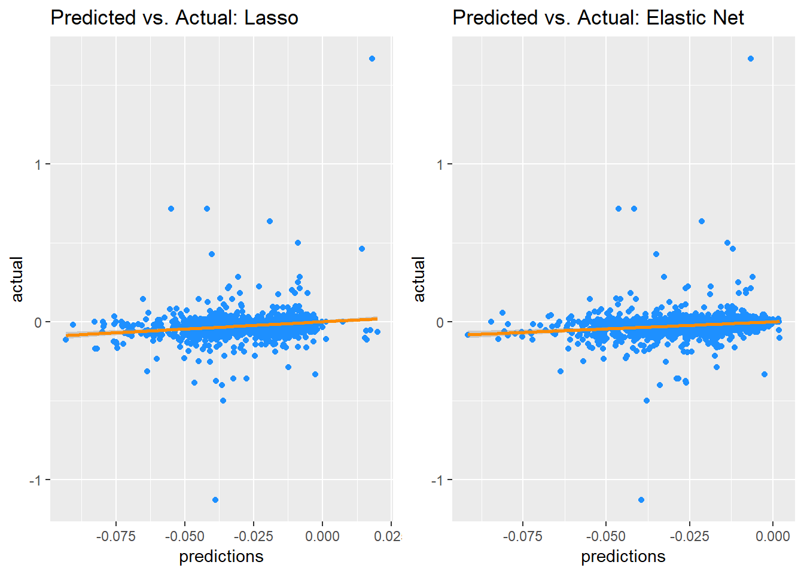
Results
Cluster 1: GBM
Average Slope (3-12 Months): -0.027

Slide 27
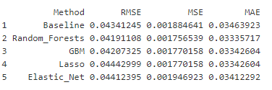
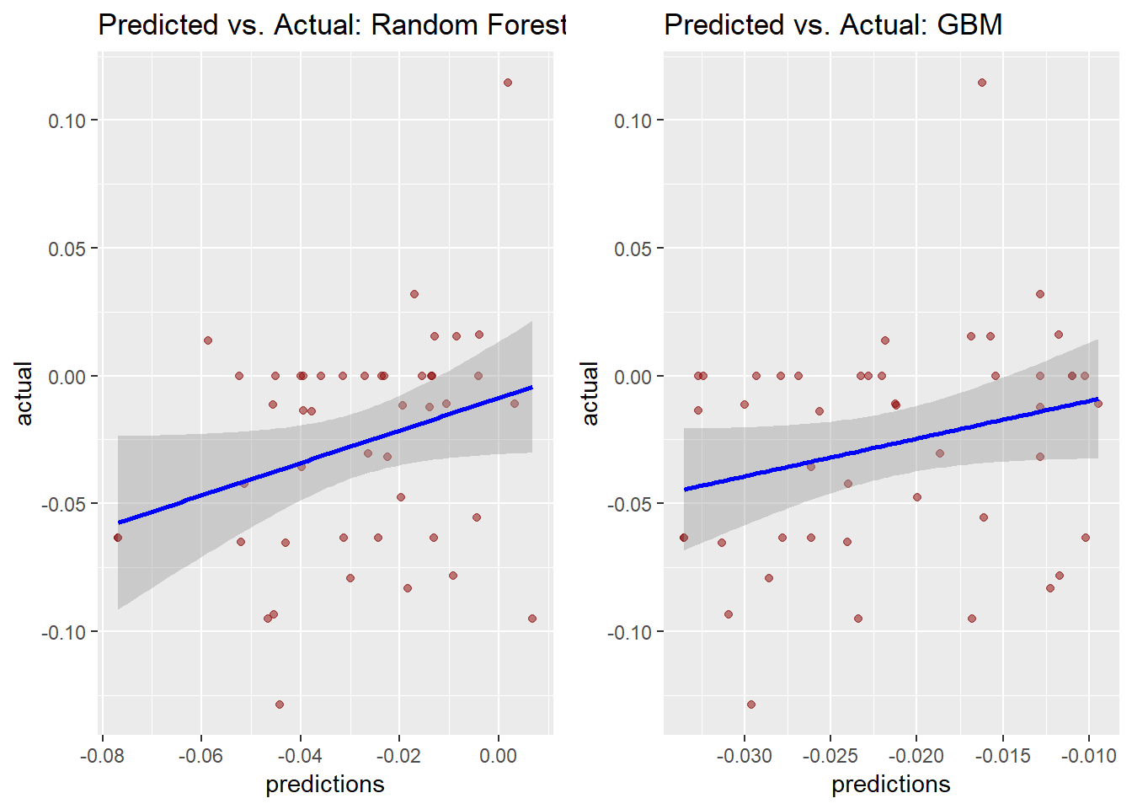
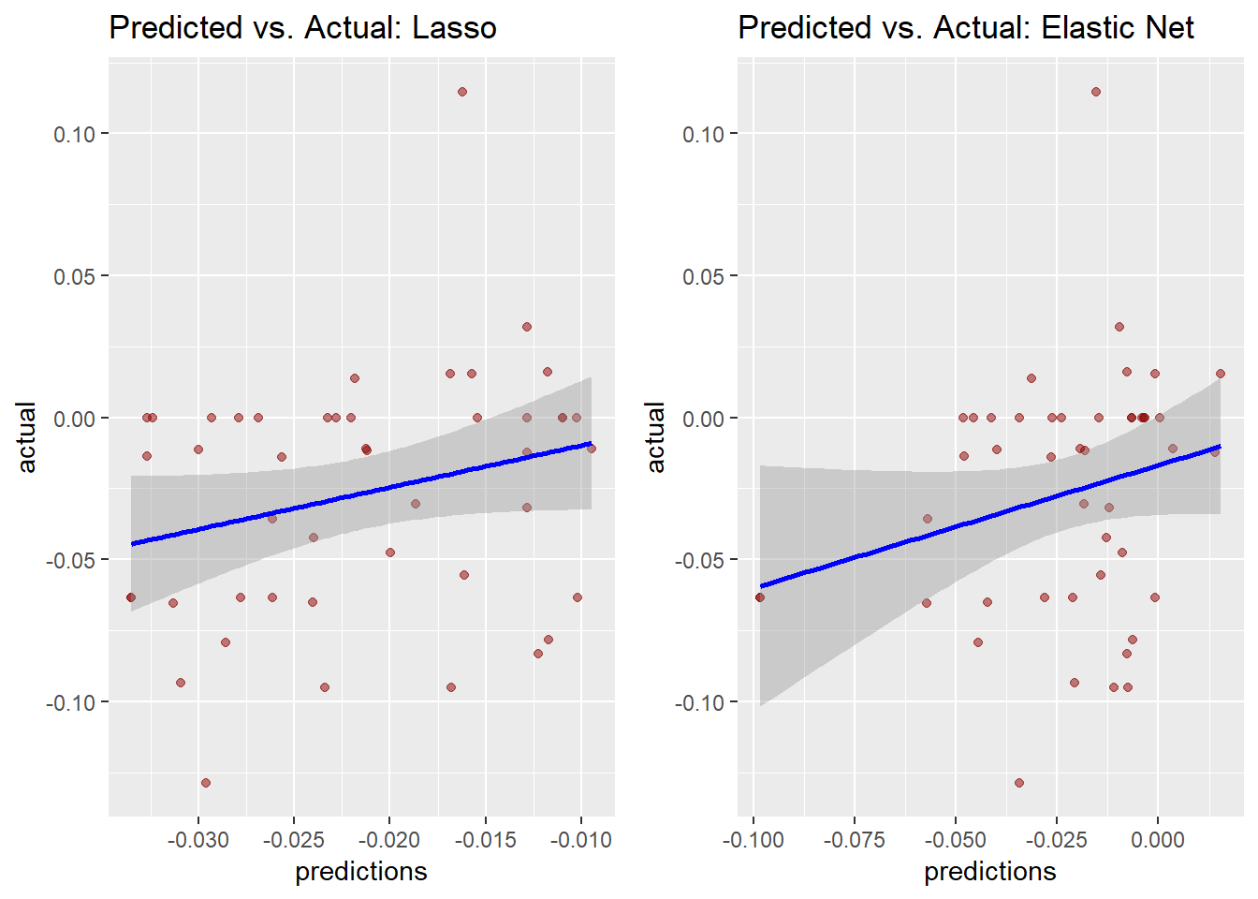
Results
Cluster 2: Random Forests
Average Slope: -0.023

Slide 28
Objectives
Background Information/Statement of Purpose
Data Preprocessing
Clustering Methods, Feature Selection and Exploration
Machine Learning Algorithm Implementations
Conclusion, Future Work, and Limitations

Slide 29
V. Conclusion, Future Work, Limitations
Features:
Cluster 2: Higher ALSFRS Score, FVC, Weight, and Creatinine
Average Slope: -0.023 in the next 3-12 Months
Cluster 1: Lower ALSFRS Score, FVC, Weight, and Creatinine
Posed for worse ALS prognosis and survival rate
Average Slope: -0.027 in the next 3-12 Months
Limitations
No access to the leaderboard (which was on the IBM server) and therefore cannot gauge our performance with actual participants
Actual participants were able to revise as many times up to until the deadline
Future Work
Perform the 2nd Sub Challenge: Prediction of Survival
Use ALS Registries dataset

Slide 30
V. References
https://theanalyticalminds.blogspot.com/2015/04/part-4a-modelling-predicting-amount-of.html?m=1&fbclid=IwAR3fVcUHmT_-IKmLA1PqfxvUX9HqvfVUZfp7Sblhnswj2TeDKCB1sda3_yE
https://consumer.healthday.com/cognitive-health-information-26/lou-gehrig-s-disease-als-news-1/blood-test-might-help-predict-survival-with-lou-gehrig-s-disease-689969.html
https://www.synapse.org/#!Synapse:syn2873386/wiki/391426

